Slide 1

appendix
What could infants, chimps and scrub-jays represent that would enable them, within limits, to track others’ perceptions, knowledge, beliefs and other propositional attitudes?

Slide 2




Intentional relation
e.g. She is interested in that chocolate
e.g. She is smiling at me
Propositional attitude
e.g. She believes that the chocolate is in that cupboard

Slide 3

Your field = a set of objects related to you by proximity, orientation, lighting and other factors
You encounter an object = it is in your field
You register an object at a location = you most recently encountered the object at that location

Slide 4
Your field = a set of objects related to you by proximity, orientation, lighting and other factors
You encounter an object = it is in your field
You register an object at a location = you most recently encountered the object at that location
proximity
orientation
lighting
barriers
trajectory

Slide 5
Your field = a set of objects related to you by proximity, orientation, lighting and other factors
You encounter an object = it is in your field
You register an object at a location = you most recently encountered the object at that location
proximity
orientation
lighting
barriers
trajectory

Slide 6
Your field = a set of objects related to you by proximity, orientation, lighting and other factors
You encounter an object = it is in your field
You register an object at a location = you most recently encountered the object at that location
Principle 1: one can’t goal-directedly act on an object unless one has encountered it.
Principle 2: correct registration is a condition of successful action.
Principle 3: when an agent performs a goal-directed action and the goal specifies an object, the agent will act as if the object were actually in the location she registers it at.
proximity
orientation
lighting
barriers
trajectory

Slide 7
Your field = a set of objects related to you by proximity, orientation, lighting and other factors
You encounter an object = it is in your field
You register an object at a location = you most recently encountered the object at that location
Principle 1: one can’t goal-directedly act on an object unless one has encountered it.
Principle 2: correct registration is a condition of successful action.
Principle 3: when an agent performs a goal-directed action and the goal specifies an object, the agent will act as if the object were actually in the location she registers it at.
proximity
orientation
lighting
barriers
trajectory

Slide 8
Your field = a set of objects related to you by proximity, orientation, lighting and other factors
You encounter an object = it is in your field
You register an object at a location = you most recently encountered the object at that location
Principle 1: one can’t goal-directedly act on an object unless one has encountered it.
Principle 2: correct registration is a condition of successful action.
Principle 3: when an agent performs a goal-directed action and the goal specifies an object, the agent will act as if the object were actually in the location she registers it at.
proximity
orientation
lighting
barriers
trajectory

Slide 9
Your field = a set of objects related to you by proximity, orientation, lighting and other factors
You encounter an object = it is in your field
You register an object at a location = you most recently encountered the object at that location
Principle 1: one can’t goal-directedly act on an object unless one has encountered it.
Principle 2: correct registration is a condition of successful action.
Principle 3
proximity
orientation
lighting
barriers
trajectory

Slide 10
Your field = a set of objects related to you by proximity, orientation, lighting and other factors
You encounter an object = it is in your field
You register an object at a location = you most recently encountered the object at that location
Principle 1: one can’t goal-directedly act on an object unless one has encountered it.
Principle 2: correct registration is a condition of successful action.
Principle 3: when an agent performs a goal-directed action and the goal specifies an object, the agent will act as if the object were actually in the location she registers it at.
proximity
orientation
lighting
barriers
trajectory

Slide 11
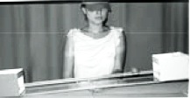
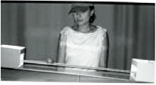
source Träuble, Marinovic, & Pauen (2010)

Slide 12
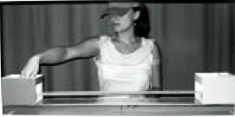
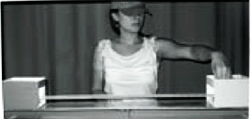
source Träuble, Marinovic, & Pauen (2010)

Slide 13
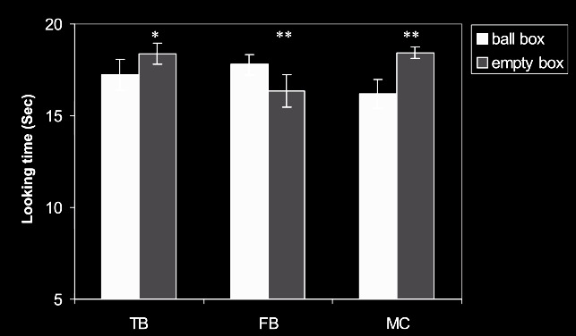
source Träuble, Marinovic, & Pauen (2010)

Slide 14
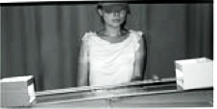
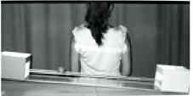
source Träuble, Marinovic, & Pauen (2010)

Slide 15
source Träuble, Marinovic, & Pauen (2010)

Slide 16
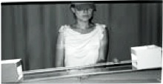
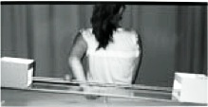
source Träuble, Marinovic, & Pauen (2010)

Slide 17
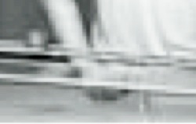
source Träuble, Marinovic, & Pauen (2010)

Slide 18
source Träuble, Marinovic, & Pauen (2010)

Slide 19
Your field = a set of objects related to you by proximity, orientation, lighting and other factors
You encounter an object = it is in your field
You register an object at a location = you most recently encountered the object at that location
Principle 1: one can’t goal-directedly act on an object unless one has encountered it.
Principle 2: correct registration is a condition of successful action.
Principle 3: when an agent performs a goal-directed action and the goal specifies an object, the agent will act as if the object were actually in the location she registers it at.
proximity
orientation
lighting
barriers
trajectory

Slide 20
Your field = a set of objects related to you by proximity, orientation, lighting and other factors
You encounter an object = it is in your field
You register an object at a location = you most recently encountered the object at that location
Principle 1: one can’t goal-directedly act on an object unless one has encountered it.
Principle 2: correct registration is a condition of successful action.
Principle 3: when an agent performs a goal-directed action and the goal specifies an object, the agent will act as if the object were actually in the location she registers it at.
proximity
orientation
lighting
barriers
trajectory

Slide 21
Principle 2: correct registration is a condition of successful action.
source Träuble, Marinovic, & Pauen (2010)

Slide 22
signature limits

Slide 23
1. Charly is Samantha
2. Mitch believes that Charly is in Baltimore
3. Mitch believes that Samantha is in Baltimore
(1) & (2) ⇒ (3)

Slide 24
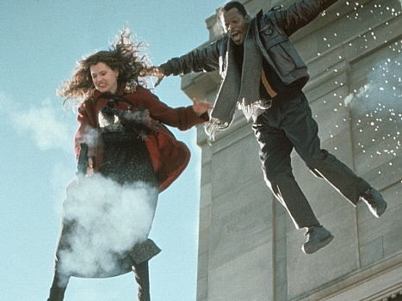
1. Charly is Samantha
2. Mitch believes that Charly is in Baltimore
3. Mitch believes that Samantha is in Baltimore
(1) & (2) ⇒ (3)

Slide 25
1. Charly is Samantha
2. Mitch believes that Charly is in Baltimore
3. Mitch believes that Samantha is in Baltimore
(1) & (2) ⇒ (3)
4. Mitch registers <Charly, Baltimore>
5. Mitch registers <Samantha, Baltimore>
(1) & (4) ⇒ (5)

Slide 26
False belief about location
False belief about identity
Subjects represent registration
Subjects represent beliefs
pass
fail
pass
pass

Slide 27
